Slide 1
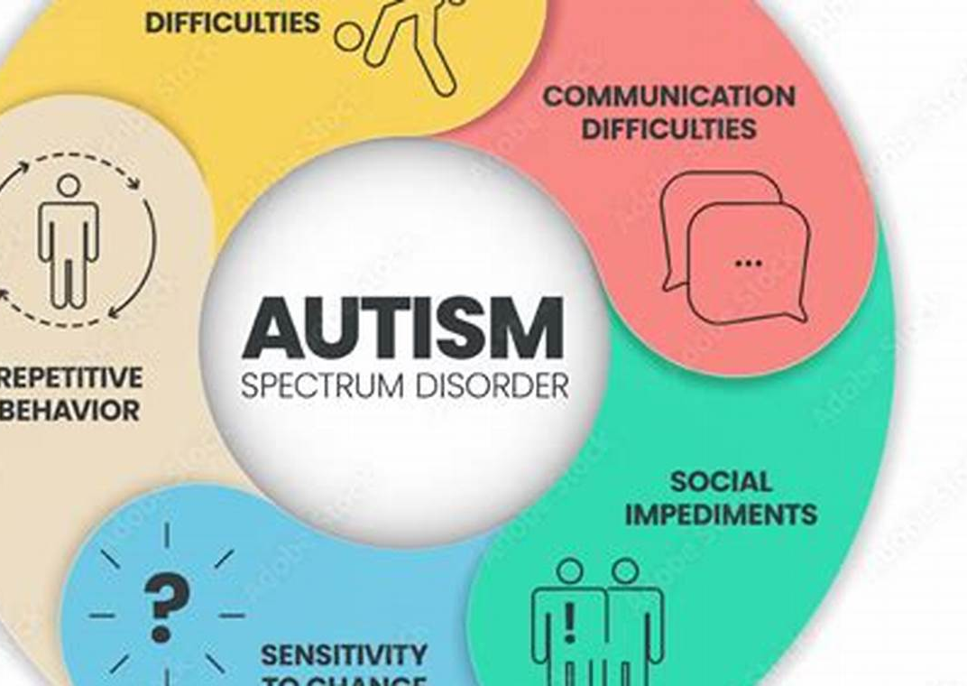
ASD Prevalence Analysis
By Janvi Mehendale
Tools : Excel | SQL | Power BI

Slide 2
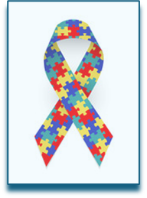
Abbreviations
ASD - Autism Spectrum Disorder
CDC – Centers for Disease Control and Prevention
NIH – National Institute of Health

Slide 3
Data sources
NSCH – National Survey of Children’s Health
NSCH is an annual, cross-sectional, address-based survey that collects information on the health and well-being of children ages 0-17 years, and related health care, family, and community-level factors that can influence health.
SECC – Special Education Child Count
CDC used special education child count data to report the number of children 6–17 years old with ASD who are receiving special education and related services in each state.
Medicaid
CMS data for each state with available data for identified children 3–17 years old who had received Medicaid benefits, were continuously enrolled in Medicaid for at least 89 days, and had at least two outpatient billing codes for ASD or one inpatient billing code in the specified year. Data from 2014 and 2015 were excluded due to data quality issues for diagnosis codes.
ADDM – Autism and Developmental Disabilities Network
ADDM Network sites collect data from health and/or education records of 8-year-old children using the same methods across sites.

Slide 4
Autism Spectrum Disorder
Autism Spectrum Disorder is a neurodivergent condition that affects how an individual learns, communicates, behaves, and processes everything happening around them. Each person experiences it differently depending on their strengths, challenges and the support they get.

Slide 5
Autism Spectrum Disorder
The purpose of the study is to understand the trends associated with the increase in the early identification of ASD. How have autism prevalence rates changed over time and what demographic or geographic conditions correlate with the trend. The project uses publicly available data from CDC, healthdata.gov and NIH. The assumption is the available data is accurate with the challenge that there might be many undiagnosed or unreported cases.

Slide 6
Key Insights
Autism prevalence rates across U.S. states since 2000.
Trends by demographic conditions.
Prevalence based on gender
Rates by Cumulative Incidence from 2018-2022.

Slide 7
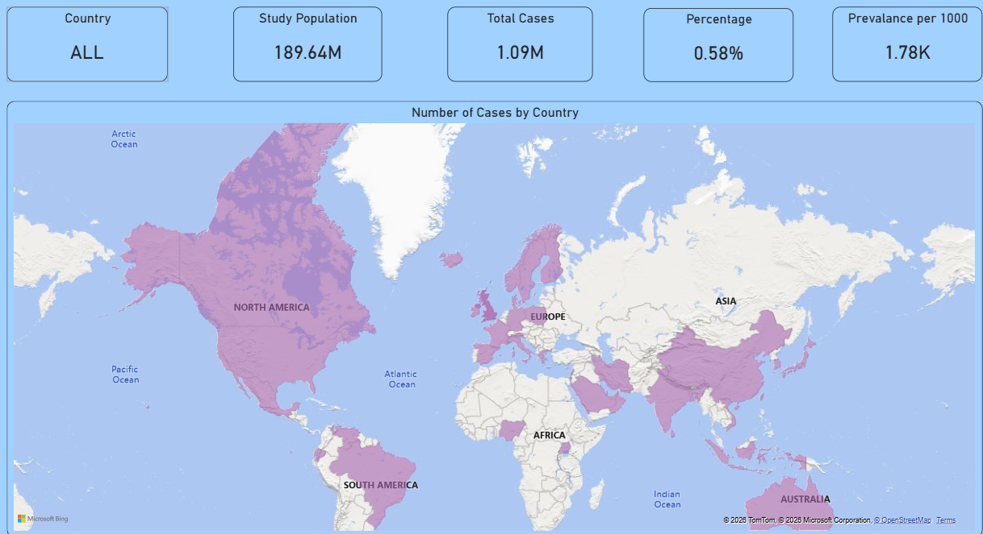
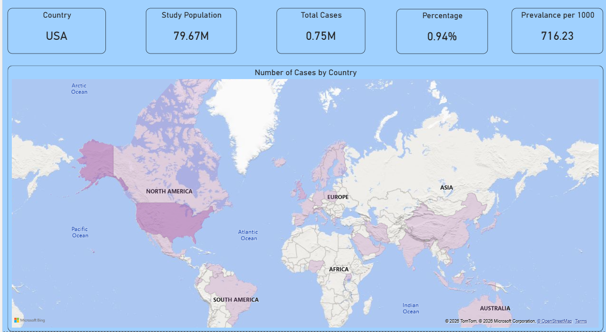
Based on the available data, USA has the most cases; so, the analysis will be conducted on USA from 2000-2022.

Slide 8
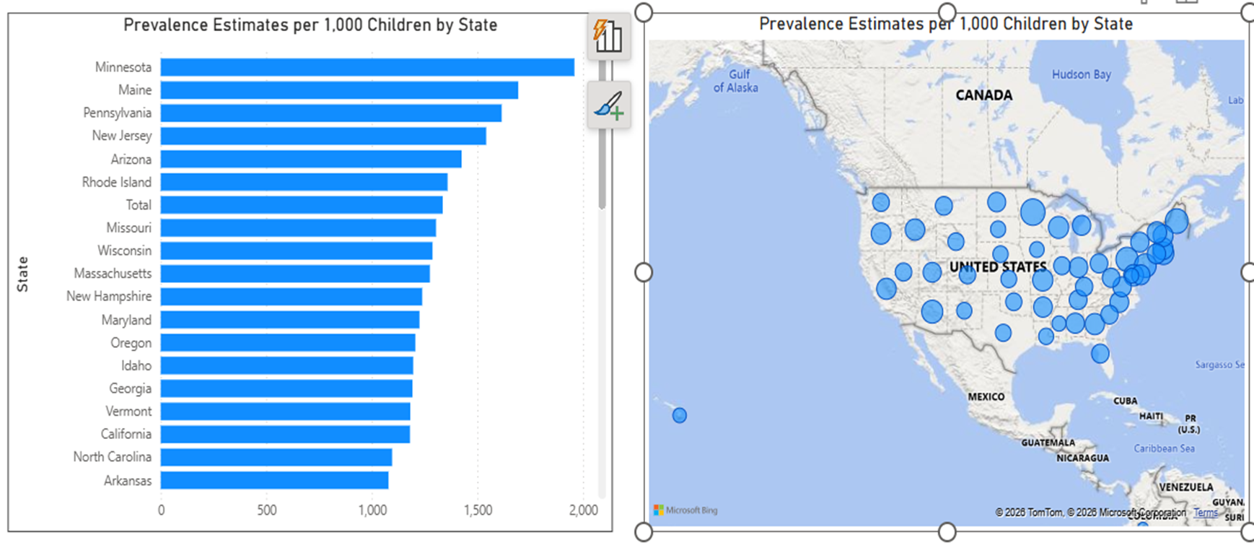
Minnesota has the most cases - 1959 and Puerto Rico has least – 285 per 1000 cases.

Slide 9
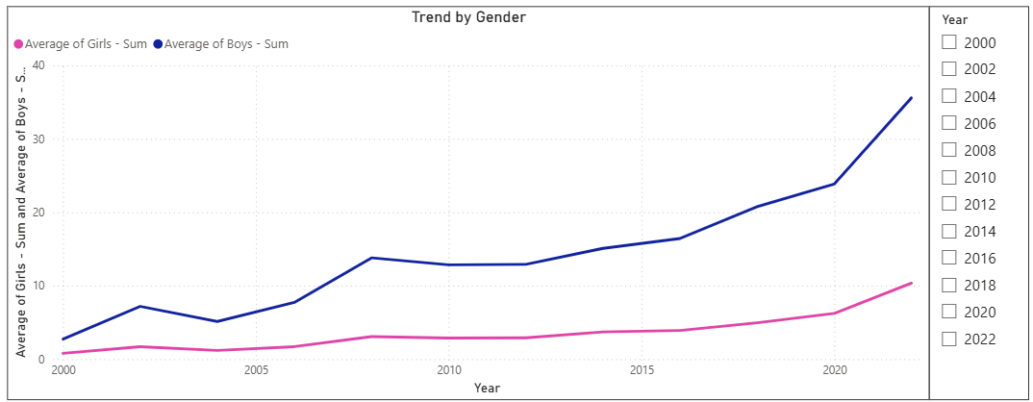
Boy ratio is higher than girl ratio and this trend has been the same since 2000

Slide 10
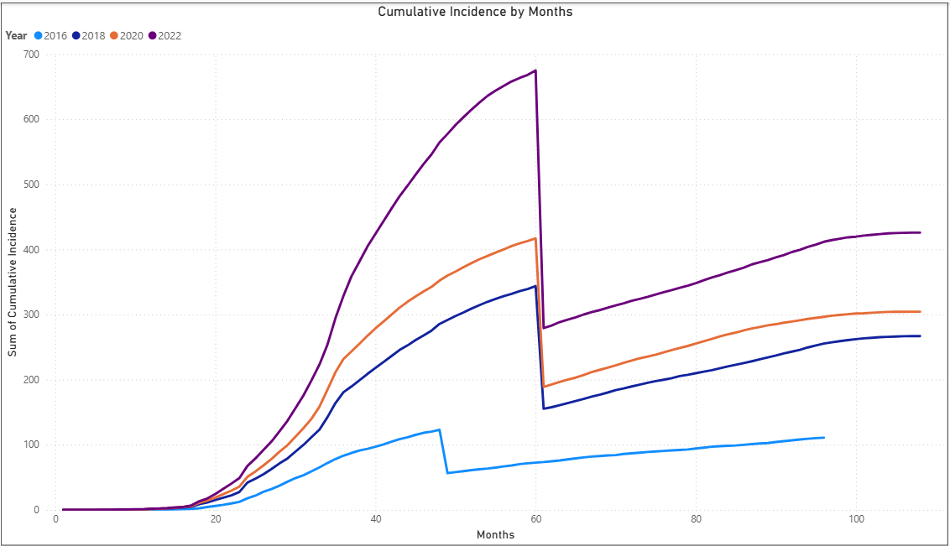
Early identification has increased over the years. Most of the cases are identified before the child is 5 years (60 months)

Slide 11
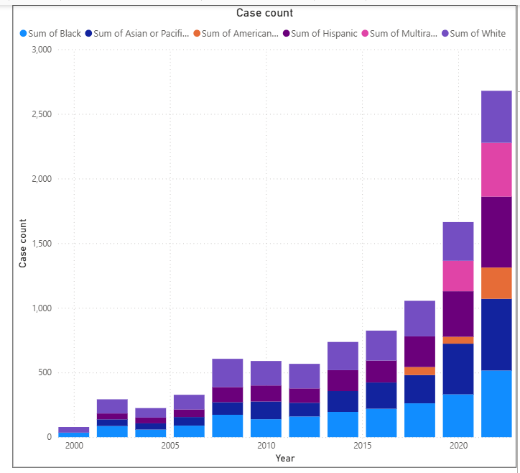
From the year 2000 till 2005, the case identification was less and mostly for White, followed by Black, Hispanic and Asian. Since 2020, all other races have started getting diagnosed and count of cases has increased.

Slide 12
Analysis
Based on the analysis, autism prevalence has increased across geographic regions and demographic groups . This increase is mostly because people are more aware of autism, better screening services are available, and services are easier to access. As families, teachers, and healthcare providers learn more about autism, children are being identified earlier. Early identification helps children get the support they need at home and in school, which can lead to better outcomes.

